Slide 2


Performance of the PRMS in Long-Term investments Decisions focusing on Coal Seam Gas to LNG Projects
Don McMillan
Oil Gas CBM Services Pty Ltd

Slide 3
Objective
The last decade over $70BN has been spent in Queensland Australia to develop Coal Seam Gas [CSG] resource for the LNG export market. In the last two decades CSG production has grown from 150 Mm3[1999] to 40,100 Mm3 [2019]. There are 4 main projects:
ALPNG [Origin Operator]
QGC [Shell operator]
GLNG [Santos operator]
Arrow Energy [Shell – Petrochina]
All projects have experienced write-downs and the original shareholders have yet to experience the benefit of this investment.
This presentation analyses the role and performance of the PRMS in these projects

Slide 4
Why do we do reserve estimates? | How good are the estimates?
Central to Financial Investment Decision [FID] | All shareholders have lost value
Under-pin Gas contracts | Out of the 6 LNG trains only 5 have been filled.
Valuation of assets | Generally over-valued Followed by write-downs
Observations.
All the projects have had write-downs.
Would the shareholders of the companies participating in the QLD CSG-LNG projects be better off if their respective projects did not proceed?
Could we have avoided the current domestic gas crisis?
What role does the PRMS has in this situation?

Slide 5
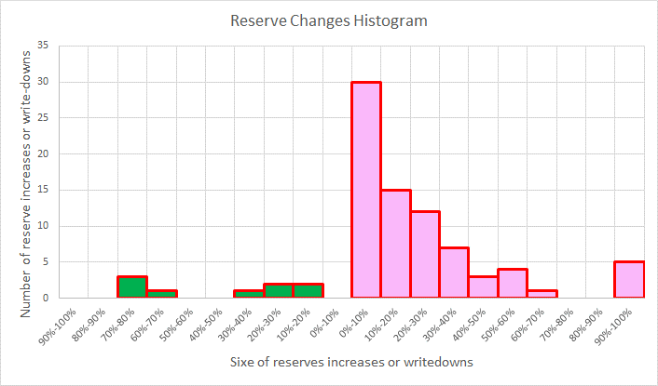
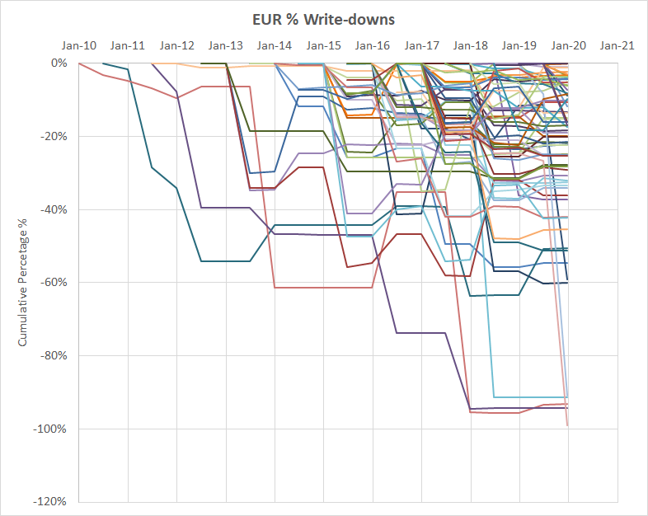
How good are we estimating 2P reserves? 87% of 2P reserves [Minimum 5 years production] lodged with the QLD Gov. have experience write-downs.
Reserve Increases
Reserves Write-downs
Results
Sample Size = 77 PL’s
67 PL’s or 87% of PL reserves experienced write-downs – Mathematical outcome.
As per PRMS it should be 50:50

Slide 6
Who is the PRMS’ audience?
PRMS is a guideline
PRMS is Project Based
Reports to the project manager
SPE sphere of influence does not extend beyond the Project
Regulatory Framework not included!!
Comparing reserves from one company to another would require a regulator framework.
Ensure honesty in reporting
Public
Government Bodies
Project Owners
Stakeholders
Native Title
Landowners
EPA
Investors
Banks
Financiers
Project
Company management
Opinion: The integration between the PRMS and Regulatory Frameworks is poorly done.
Regulators
Shareholders

Slide 7
Opinion: Recommendations to improve confidence in Reserves Reporting
SPE develop guidelines or recommendations to assist regulators
Reserve Estimators develop tools to “self-police” reserve reporting
E.G Reserve Confidence Metric
modified version of the reserves-production ratio
Ref:
1: SPE JPT Article March 2018. Is there a need for a Reserve Confident Metric? https://doi.org/10.2118/0318-0054-JPT
2: APPEA Journal 2017, 57, Conference May 2017 Perth: Gauging the confidence in publicly reported oil and gas reserves Introducing the Reserves Confidence Metric; http://dx.doi.org/10.1071/AJ16050

Slide 8
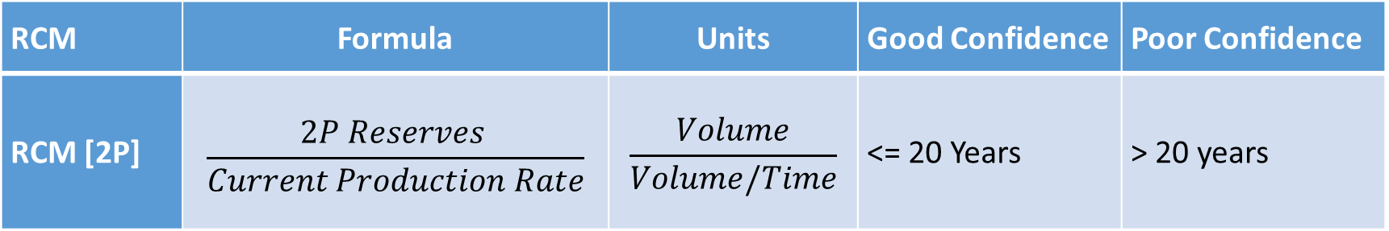
Reserves Confidence Metric RCM [Ref: https://doi.org/10.2118/0318-0054-JPT]
RCM | Formula | Units | Good Confidence | Poor Confidence
RCM [2P] | $$\frac{2P Reserves }{Current Production Rate}$$ | $$\frac{Volume}{Volume/Time}$$ | <= 20 Years | > 20 years
Poor confidence does not mean the reserves are wrong, it means that the reserve estimates are to be used with caution or further information is required.
RCM is independent of the disclosing entity, Reserve Estimator, & Auditor
No knowledge of geology engineering etc required.
Empower Stakeholders

Slide 9
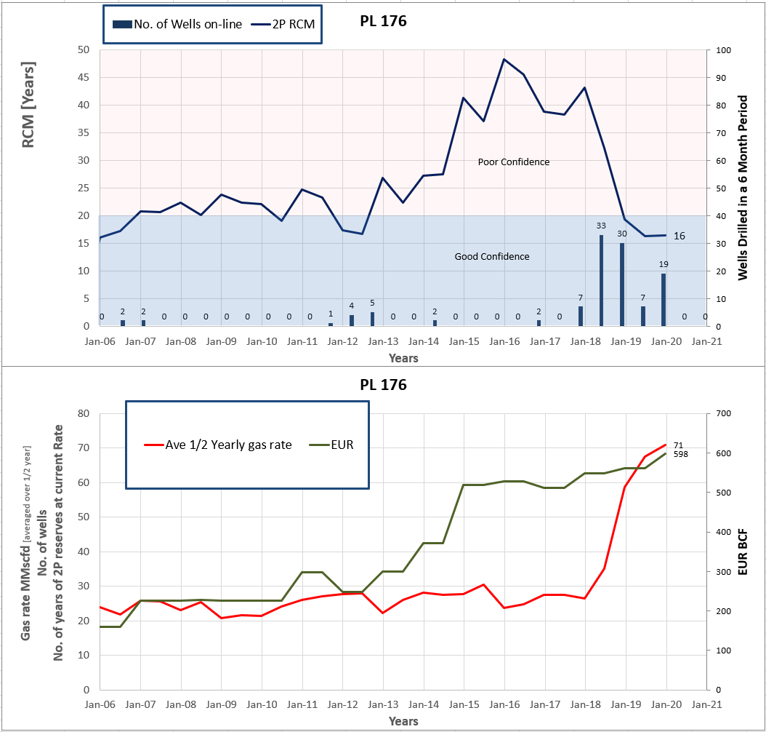
Example 1 of a CSG Field in Queensland
Production > 10 years
Reserves Growth [Undeveloped]
Drilling commenced <5yrs
Production Growth to justify the Reserve Increase.

Slide 10
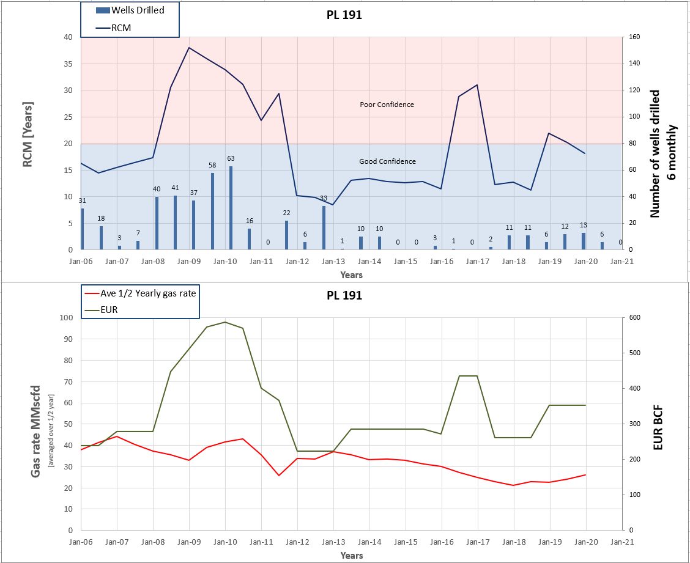
Example 2 of a CSG Field in Queensland
Production > 10 years
The Operator prepared to reduce reserves.
Drilling seems not to be successful
Write-downs imply initial 2P allocation was incorrect.

Slide 11
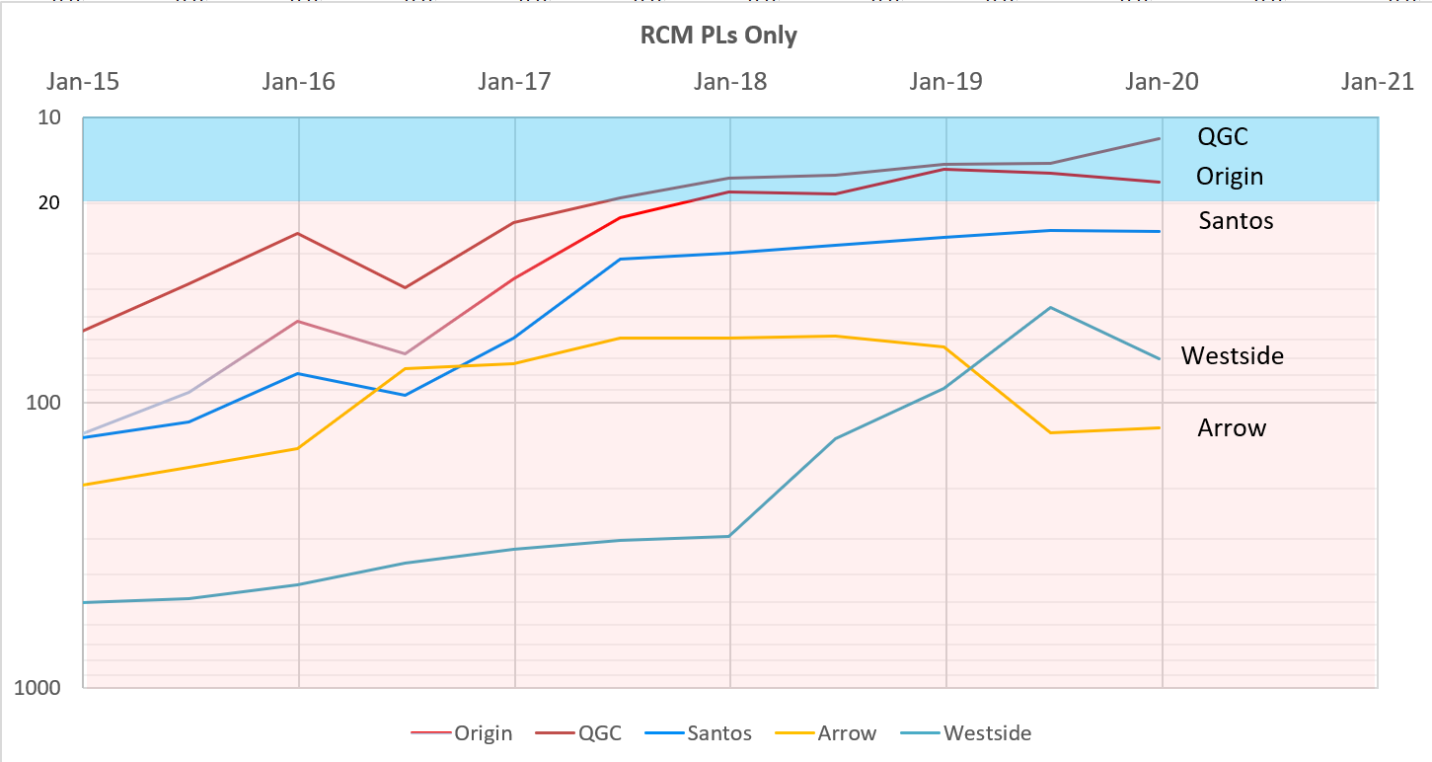
RCM used at a company level: CSG in Queensland
Good Confidence
Poor Confidence
Note 2P reserves are the only resource information available

Slide 12
Summary and Conclusion
The poor performance of the Queensland CSG-LNG projects highlights the important role the PRMS and regulatory bodies in ensuring the integrity of the Petroleum Industry.
Regulatory framework is critical to governance of the integrity of the PRMS
Recommendations:
SPE consider developing guidelines for regulatory framework for the PRMS
Reserve estimators need to develop self-policing mechanisms to ensure integrity in the PRMS.

Slide 13
Source of data spporting the following slides
2P reserves and Production data [31 Dec 2019]
The Government has not released 30 June 2020 production data.
Queensland Government Open Data Portal
https://www.data.qld.gov.au/dataset/petroleum-gas-production-and-reserve-statistics
Plots and Graphs
Source is on each slide
Papers [download from www.oilgascbm.com.au]
SPE JPT Article March 2018. Is there a need for a Reserve Confident Metric? https://doi.org/10.2118/0318-0054-JPT
APPEA Journal 2017, 57, Conference May 2017 Perth: Gauging the confidence in publicly reported oil and gas reserves Introducing the Reserves Confidence Metric; http://dx.doi.org/10.1071/AJ16050
Workshop and Survey Focus on SPE Petroleum Resources Management System[April 2014 SPE JPT https://doi.org/10.2118/0414-0038-JPT ]
2012 APPEA paper – Why North American markets have shifted to spoolable pipes.
SPE-PRMS and Reserves reporting in Australia – PESA Dec/Jan 2009/2010
CBM Fracture Simulation an Australian Experience – SPE 110137; https://doi.org/10.2118/110137-MS

